Slide 1
What is OpenGL ?
OpenGL is a software interface to graphics hardware. This interface consists of about 150 distinct commands that one can use to specify the objects and operations needed to produce interactive three dimensional applications.
OpenGL is designed to be independent of any window system or operating system
So it does not contains any commands for opening windows or reading events from the keyboard or mouse.
GLUT( OpenGL utility Toolkit) is used to develop graphics applications with opening a window, handle keyboard and mouse events

Slide 2
OpenGL commands use the prefix gl and initial capital letters for each word making up the command name
GLUT routines use glut prefix
Window management commands
glutInit(int *argc,char **argv) : initializes GLUT and processes any command line arguments
glutInitDisplayMode(GLUT_SINGLE|GLUT_RGB) : single frame buffer and RGB color mode
glutInitWIndowPosition(int x,int y) : position of upper-left corner of window
glutInitWindowSize(int width,int size)
glutCreateWindow(char *string) : create a window

Slide 3
Display callback
glutDispalyFunc(void(*func)(void):whenever
GLUT determines the contents of the window need to be redisplay , the callback function registered by glutDisplayFunc() is executed
Whenever program changes the contents of the window ,we have to call glutPostRedisplay(void) which gives glutMainLoop() a nudge to call the registered display callback.

Slide 4
Sample example
#include <glut.h>
Void display()
{
glClear(GL_COLOR_BUFFER_BIT);
glColor3f(1,1,1); set white color
glFlush(); /* forces all previously issued OpenGLcommands to begin execution
}
Void init()
{
glClearColor(0,0,0,0);
}
Void reshape(int w,int h)
{
glViewpoprt(0,0,(GLsizei)w,GLsizei)h); /* (x,y,width,height)
gluOrtho2D(0.0,160.0,0.0,120.0); /* (left,right,bottom,top)
}

Slide 5
Void main(int argc,char *argv[])
{
glutInitDisplayMode(GLUT_SINGLE|GLUT_RGB);
glutInitWindowSize(320,240);
glutCreateWindow(“MY first OpenGL Window”);
Init();
glutDisplayFunc(Display);
glutReshapeFunc(reshape); reshape function will be called whenever the window resizes itself which includes the first time it is drawn on the screen)
glutMainLoop();
}

Slide 6
Plotting points and lines
Draw a point with
glVertex{2,3,4}{s,l,d,f} : {2,3,4} specifies how many coordinates ? {s,I,d,f} specifies the arguments are short , integers, double precision or floating point
Primitives can be specified by bracketing set of vertices between
glBegin(primitive name) and glEnd()
Primitive name :
GL_POINTS ,GL_LINES,GL_LINE_STRIP , GL_LINE_LOOP,GL_TRIANGLES ,GL_POLYGON
Point size can be specified by glPointSize(1.0)

Slide 7
Geometric transformation
glMatrixMode(GL_MODELVIEW) :specify current matrix so subsequent transformation call affect that matrix
glLoadIdentify()
glTranslatef(dx,dy,dz)
glScalef(sx,sy,sz)
glRotatef(angle,vx,vy,vz)
glLoadMatrixf(M);
glMultMatrixf(M); : M is 4*4 matrix OpenGL represent them as 16-element arrays. The element in the ith row and jth column is represented by M[i+j*4]
New matrix M is multiplied current matrix C as
CM
Finally CMv takes place i.e. last operation is applied first to vertices so all matrices should be specified in reverse order

Slide 8
OpenGL implementation
1 set up the camera (viewing transformation)
gluLookAt(position,direction,up vector)
2 arrange the object to desired position (modeling transformation)
glRotatef(), glTranslatef(),glScalef()
3 Choose a camera lens or adjust the zoom (projection transformation)
glOrtho(left ,right ,bottom, top,near,far)
gluPerspective(angle of field of view(fovy),aspect ratio(w/h),near ,far)
4 viewport transformation : determine how large you want the final image glViewport(x,y,width,height)
The (x, y) parameter specifies the lower-left corner of the viewport

Slide 9
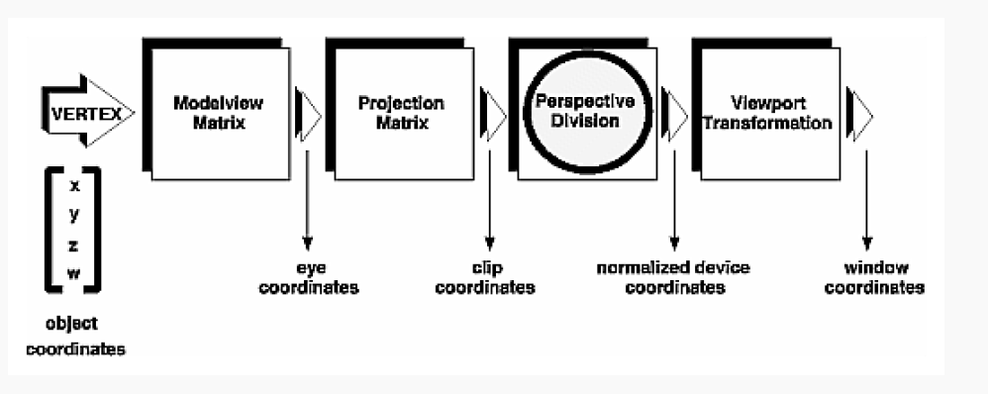
OpenGL implementation
order in which these operations occur on your computer.

Slide 10
OpenGL implementation
glMatrixMode(GL_MODELVIEW);
glLoadIdentity();
glMultMatrixf(N); /* apply transformation N */
glMultMatrixf(M); /* apply transformation M */
glMultMatrixf(L); /* apply transformation L */
glBegin(GL_POINTS);
glVertex3f(v); /* draw transformed vertex v */
glEnd();
N(M(Lv)) - that is, v is multiplied first by L, the resulting Lv is multiplied by M, and the resulting MLv
is multiplied by N.
glPushMatrix();
glPopMatrix();

Slide 11
Handling Input Events
You can use these routines to register callback commands that are invoked when specified events occur.
l glutReshapeFunc(void (*func)(int w, int h)) indicates what action should be taken when the window is resized.
glutKeyboardFunc(void (*func)(unsigned char key, int x, int y))
glutMouseFunc(void (*func)(int button, int state,
int x, int y)) allow you to link a keyboard key or a mouse button with a routine that's invoked when the key or mouse
button is pressed or released.
void keyb(unsigned char key, int x, int y){
if(key==49){
angle=angle+10;
angle=angle%360;
glutPostRedisplay();
}
glutKeyboardFunc(keyb);
glutMouseFunc(mouse);

Slide 12
void mouse(int button,int state,int x,int y)
{
switch(button)
{
case GLUT_LEFT_BUTTON:if(state==GLUT_DOWN)
anglex=anglex+10;
anglex=anglex%360;
glutPostRedisplay();
break;
default : break;
}
}

Slide 13
Lighting
1 Define normal vectors for each vertex of all the objects
2 Create, select, position and enable one or more light sources
glLightfv(GL_LIGHT0,GL_POSITION,light_position) create light source
glEnable(GL_LIGHT0) enable light source
glEnable(GL_LIGHTING): enable lighting calculation
3 Create and select lighting model : define viewpoint position, global ambient light and lighting calculation on one side or two side
glLightModel()
4 Define material properities
glMaterialfv()

